Slide 1
IS 466 Decision Support Systems
Lecture 1
Preliminaries and Overview
The slides content is derived and adopted from many references

Slide 2
Outline
Definition
Structure of a decision system
DSS models
Phases of the Decision Making
Decision makers
Continuum of Decision Structures
Decision Analysis
DSS and Data Warehouse
DSS Knowledge Base (Intelligent DSS)
Web Mining for deciders

Slide 3
Definition
“model-based set of procedures for processing data and judgments to assist a manager (decider) in his decision making” Little (1970)
  Assumption: that the system is computer-based
and extends the user’s capabilities.
Decision-support systems are used to make business decisions often based on data collected by On-line Analytical-Processing systems OLAP.
  Examples of business decisions:
    what items to stock?
    Who to send advertisements to?
  Examples of data used for making decisions
    Retail sales transaction details
    Customer profiles (income, age, gender, etc.)

Slide 4
Decision making and Management
Management is a process by which organizational goals (outputs) are achieved through the use of resources (inputs)
Measuring Success:
Productivity = Outputs / Inputs
Management is decision making
The manager is a decision maker

Slide 5
Why use of DSS
Perceived benefits
  decision quality
  improved communication
  cost reduction
  increased productivity
  time savings
  improved customer and employee satisfaction

Slide 6
Structure of a decision system (1/3)
A SYSTEM is a collection of objects such as people, resources, concepts, and procedures intended to perform an identifiable function or to serve a goal
Three Distinct Parts of Systems
  Inputs
  Processes
  Outputs
  A system surrounded by an environment
  A system Frequently include feedback

Slide 7
Structure of a decision system (2/3)
Environment
Input(s)
Output(s)
Processes
Feedback (flow of information)
Boundary
Notes:
Feedback : صدى العمل

Slide 8
Structure of a decision system (3/3)
Inputs are elements that enter the system
Processes convert or transform inputs into outputs
Outputs describe finished products or consequences of being in the system
Feedback is the flow of information from the output to the decision maker, who may modify the inputs or the processes (closed loop)
The Environment contains the elements that lie outside but impact the system's performance
Notes:
Being : كائنات

Slide 9
DSS models (1/3)
DSS is “model-based set of procedures for processing data and judgments to assist a manager (decider) in his decision making”
A model is a simplified representation or abstraction of (complex) reality.
Three groups of models
  Iconic (Scale) Model: Physical replica of a system
  Analog Model behaves like the real system but does not look like it (symbolic representation)
  Mathematical (Quantitative) Models use mathematical relationships to represent complexity used in most DSS analyses
Notes:
Scale model : نمودذج مقياسي
generally on a different scales of the original model

Slide 10
DSS models (2/3)
Benefits of Models
  Time compression
  Easy model manipulation
  Low cost of construction
  Low cost of execution (especially that of errors)
  Can model risk and uncertainty
  Can model large and extremely complex systems with possibly infinite solutions
  Enhance and reinforce learning, and enhance training

Slide 11
DSS models (3/3)
Modeling Process
  How much bread to stock each day?
  Solution Approaches
    Trial-and-Error
    Simulation
    Optimization
    Heuristics

Slide 12
Modeling and Analysis Strategies
Satisficing strategies:
  Forecasting
  Simulation
  “What if” analysis
  Markov analysis
  Complex queuing methods
  Environmental impact analysis
Optimizing strategies:
  Linear programming
  Goal programming
  Simple queuing models
  Investment models
  Inventory models
  Transportation models
Notes:
Satisficing is an alternative to optimization for cases where there are MULTIPLE and COMPETITIVE objectiveS in which one gives up the idea of obtaining a "best" solution. In this approach one sets lower bounds for the various objectives that, if attained, will be "good enough" and then seeks a solution that will exceed these bounds. The satisficer's philosophy is that in real-world problems there are too many uncertainties and conflicts in values for there to be any hope of obtaining a true optimization and that it is far more sensible to set out to do "well enough" (but better than has been done previously). (IIASA)
Satisficing is an optimization where all costs, including the cost of the optimisation calculations and the cost of getting information for use in those calculations, are considered.
http://pespmc1.vub.ac.be/ASC/SATISFICING.html
http://pespmc1.vub.ac.be/ASC/OPTIMIZATIO.html
------------------------------------------------------------------------------
Optimization is an activity that aims at finding the best (i.e., optimal) solution to a problem. For optimization to be meaningful there must be an OBJECTIVE FUNCTION (see below) to be optimized and there must exist more than one FEASIBLE SOLUTION, i.e., a solution which does not violate the constraints. The term optimization does not apply, usually , when the number of solutions permits the best to be chosen by inspection, using an appropriate criterion (see DECISION THEORY). One distinguishes SINGLE OBJECTIVE and MULTIOBJECTIVE optimization. In the first case, the objective is SCALAR-VALUED (it can be measured by a single number); in the second, the objective is VECTOR-VALUED (its value is expressed by an n-tuple of numbers). In mathematical terms, the formulation of an optimization problem involves decision variables, Xl, X2,...Xn, the objective function, Q = f(Xl,X2,..Xn)
constraint relations, usually of the form
Gi(Xl,X2,...Xn) greater than or equal to O, i = l,2,...m.
The OPTIMAL SOLUTION (or "solution to the optimization problem") is values of decision variables xl, x2,...xn that satisfy the constraints and for which the objective function attains a maximum (or a minimum, in a minimization problem). Very few optimization problems can be solved analytically, that is, by means of explicit formulae. In most practical cases appropriate computational techniques of optimization (numerical procedures of optimization) must be used. Among those techniques LINEAR PROGRAMMING permits the solution of problems in which the objective function and all constraint relations are linear. NONLINEAR PROGRAMMING does not have this restriction, but can manage many fewer decision variables and constraints. INTEGER PROGRAMMING serves to solve problems where the decision variables can take only integer values. stochastic or PROBABILISTIC PROGRAMMING must be used for problems where the objective function or constraint relations contain random-valued parameters (in the latter case, the problem is referred to as a CHANGE-CONSTRAINED PROBLEM). A special case is dynamic optimization problems where the decision variables are not real numbers or integers but functions of one or more independent variables -- functions of time or space coordinates, for example. Dynamic optimization problems are sometimes referred to as "optimal control problems." There exist special techniques to solve such problems; they often make use of DISCRETIZATION of the independent variables, for example dividing the time axis into a number of intervals and considering the solutions to be constant over those intervals. A single-objective optimization problem may have (and usually does have) a single-valued, unique solution. The solution to a multiobjective problem is, as a rule, not a particular value, but a set of values of decision variables such that, for each element in this set, none of the objective functions can be further increased without a decrease of some of the remaining object functions (every such value of a decision variable is referred to as pareto-optimal). (IIASA)

Slide 13
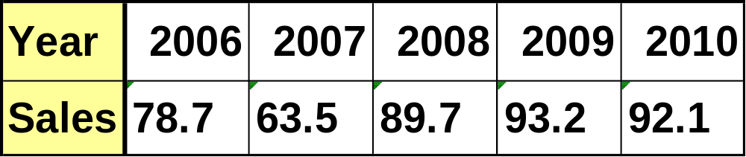
Forecasting
Time series is a set of evenly spaced numerical data obtained by observing response variable at regular time periods
Forcasting technique
  That uses a series of past data points to make a forecast
  Example: forecast 2011 sales based on the following time series

Slide 14
Simulation
Technique for conducting experiments with a computer on a model of a management system
Major Characteristics of Simulation
  Imitates reality and capture its richness
  Technique for conducting experiments
  Descriptive, not normative tool
  Often to solve very complex, risky problems
A Simulation Methodology
  Define problem
  Construct simulation model
  Test and validate model
  Design experiments
  Conduct experiments
  Evaluate results
  Implement solution
Notes:
Adj.1.normative - relating to or dealing with norms; "normative discipline"; "normative samples"
2.normative - giving directives or rules; "prescriptive grammar is concerned with norms of or rules for correct usage" prescriptivegrammar - studies of the formation of basic linguistic units
3.normative - based on or prescribing a norm or standard; "normative grammar" prescriptivereceived, standard - conforming to the established language usage of educated native speakers; "standard English" (American); "received standard English is sometimes called the King's English" (British)
4.normative - dealing with or based on norms; "a normative judgment" standard - conforming to or constituting a standard of measurement or value; or of the usual or regularized or accepted kind; "windows of standard width"; "standard sizes"; "the standard fixtures"; "standard brands"; "standard operating procedure"

Slide 15
Phases of the Decision Making (1/2)
Intelligence phase
  Reality is examined
  The problem is identified and defined
Design phase
  Representative model is constructed
  The model is validated and evaluation criteria are set
Choice phase
  Includes a proposed solution to the model
  If reasonable, move on to the
Implementation phase
  Solution to the original problem
  Failure: Return to the modeling process

Slide 16
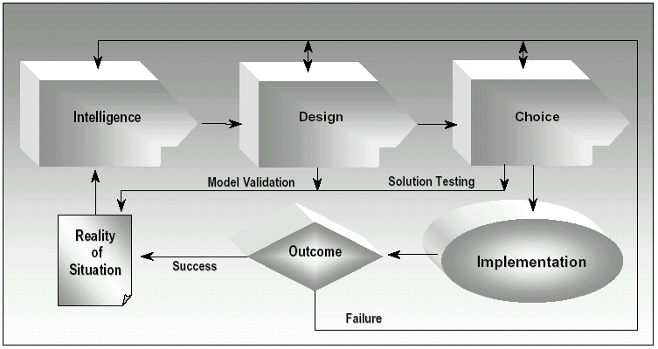
Phases of the Decision Making (2/2)
Simon’s Model

Slide 17
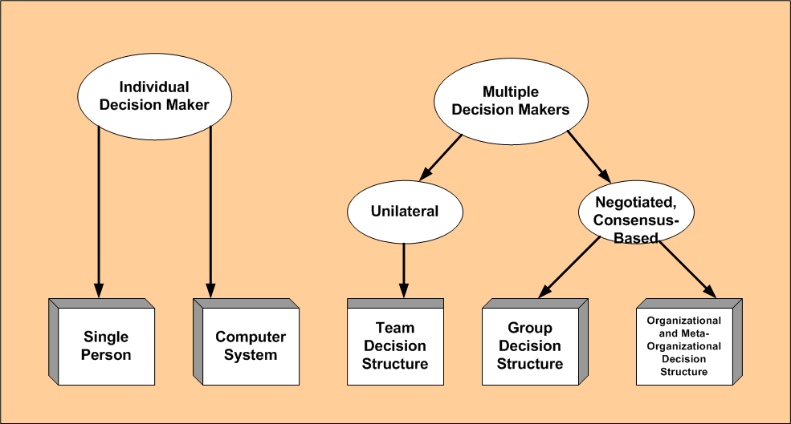
Decision makers: Who are They? (1/3)
The decision maker plays a schizophrenic role since he is considered both a step in the process and also a participant.
Many different types of DSSs exist because there are many different types of decision makers.
Notes:
Unilateral : أحادي الجانب
مَفْصُوم schizophrenic

Slide 18
Decision makers: Who are They? (2/3)
Decision Maker Classifications
  Individual decision makers can be a single person or a computer system.
  Multiple decision makers can be:
    teams where members support a single decision maker,
    groups where all members have a say in the decisions, or
    organizational where global agreement is needed.

Slide 19
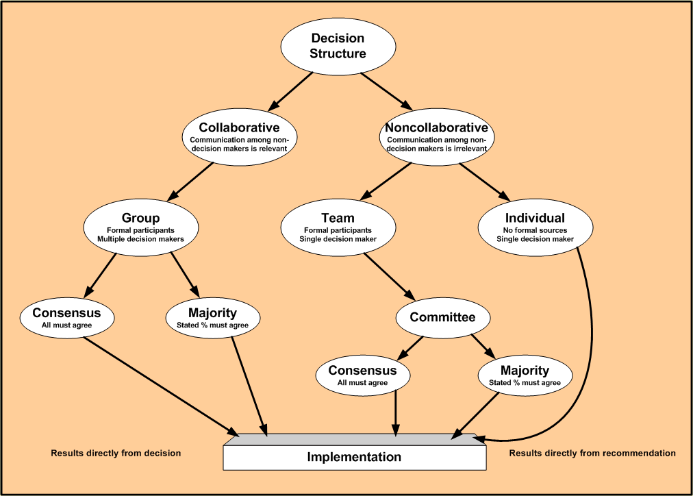
Decision makers: Who are They? (3/3)
Classification of Decision Structures

Slide 20
Continuum of Decision Structures
Decision phases: Intelligence, Design, choice
Structured problems: are routine problems for which standard solution methods exist
  Existence of all structured phases
    Procedures for obtaining the best solution are known
    Objectives are clearly defined
Unstructured problems: are fuzzy, complex problems for which there are no cut-and-dried solution methods
  have no structured phase
  often solved with human intuition
Semi-structured problem: is a decision problem in which some but not all of the phases are structured.
  in between solve with standard solution procedures and human judgment
Notes:
cut-and-dried precise:

Slide 21
Why are Decisions So Hard?
The four key areas that determine the relative difficulty of a decision are:
  Structure – in general, the more structure, the less information required
  Cognitive limitations – the human mind is limited to handling 5 to 9 distinct pieces of information
  Uncertainty – the amount is based on how complete and accurate the information is
  Alternatives and multiple objectives – the selection of one alternative may impede the progress towards a different goal
IS 466 - Preliminaries and Overview
Notes:
Cognitive limitations الحدود المعرفية

Slide 22
Decision Analysis (1/2)
Decision Analysis provides a framework for making important decisions.
Decision Analysis allows us to select a decision from a set of possible decision alternatives when uncertainties regarding the future exist.
The goal is to optimize the resulting return (payoff) in terms of a decision criterion.
IS 466 - Preliminaries and Overview -

Slide 23
Decision Analysis (2/2)
The types of decision analysis models:
  Decision making under certainty
    The future state of nature (event) is assumed known.
  Decision making under uncertainty
    There is no knowledge about the probability of the states of nature occurring.
  Decision making under risk
    There is (some) knowledge of the probability of the states of nature occurring.
  Decision making with perfect information
  Decision making with imperfect information (Bayesian Theory)
  Decision making in light of competitive actions (Game theory)
    All the actors (players) are seeking to maximize their return.
IS 466 - Preliminaries and Overview -

Slide 24
DSS and Data Warehouse
Data warehouse is a decision support database that is maintained separately from the organization’s operational databases.
The Data Warehouse is an integrated, subject-oriented, time-variant, non-volatile database that provides support for decision making.
  Integrated
    The Data Warehouse is a centralized, consolidated database that integrates data retrieved from the entire organization.
  Subject-Oriented
    The Data Warehouse data is arranged and optimized to provide answers to questions coming from diverse functional areas within a company.
  Time Variant
    The Warehouse data represent the flow of data through time. It can even contain projected data.
  Non-Volatile
    Once data enter the Data Warehouse, they are never removed.
    The Data Warehouse is always growing.
IS 466 - Preliminaries and Overview -
Notes:
13

Slide 25
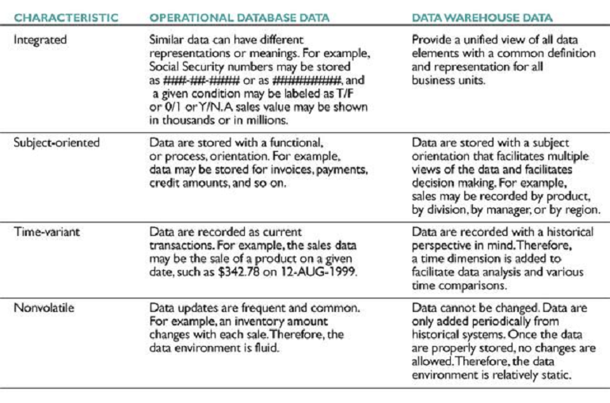
Comparison Of Data Warehouse
And Operational Database Characteristics
IS 466 - Preliminaries and Overview -

Slide 26
On-Line Analytical Processing
On-Line Analytical Processing (OLAP) is an element of DSS.
Goal of OLAP is to support ad-hoc querying for the business analyst
Business analysts are familiar with spreadsheets
Extend spreadsheet analysis model to work with warehouse data
  Large data set
  Semantically enriched to understand business terms (e.g., time, geography)
  Combined with reporting features
Multidimensional view of data is the foundation of OLAP
IS 466 - Preliminaries and Overview -

Slide 27

Multidimensional Data
Date
1Qtr
2Qtr
3Qtr
4Qtr
sum
Product
TV
PC
Mekkah
DVD
sum
Madinah
City
Quds
sum
All, All, All
IS 466 - Preliminaries and Overview -

Slide 28
OLAP opeartions
Aggregation (roll-up)
  dimension reduction: e.g., total sales by country
  summarization over aggregate hierarchy
    e.g., total sales by country and year
Selection (dice) defines a subcube
  e.g., sales where city = Mekkah and product = TV
  A slice is a dice with one condition
Navigation to detailed data (drill-down)
  e.g., sales by month
Visualization Operations (e.g., Pivot)
IS 466 - Preliminaries and Overview -

Slide 29
DSS Knowledge Base (Intelligent DSS)
Any true decision requires reasoning, which requires information.
The knowledge base is where all of this information is stored by the DSS.
Knowledge can just be raw information, or rules, heuristics, constraints or previous outcomes.
This knowledge is different from information in either the database or model base in that it is problem-specific.
IS 466 - Preliminaries and Overview -

Slide 30
Contents of the Knowledge Base
Knowledge in the base can be categorized into two simple groups.
  Facts represent what we know to be true at a given time.
  Hypotheses represent the rules or relationships we believe to exist between the facts.
    The next slide shows how credit rules operate on facts about an individual that has applied for a loan.
IS 466 - Preliminaries and Overview -

Slide 31
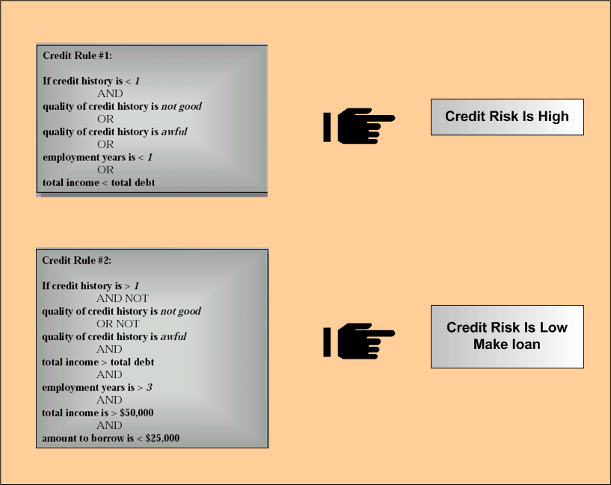
Examples of Credit Rule Combinations
IS 466 - Preliminaries and Overview -
Notes:
Awful : سئ

Slide 32
The Inference Engine
Here, the knowledge is put to use to produce solutions
The engine is capable of performing deduction or inference based on rules or facts
Also capable of using inexact or fuzzy reasoning based on probability or pattern matching
IS 466 - Preliminaries and Overview -

Slide 33
Web mining for deciders
Web: A huge, widely-distributed, highly heterogeneous, semi-structured, hypertext/hypermedia, interconnected, evolving information repository.
Web mining: Extraction of interesting (non-trivial, implicit, previously unknown and potentially useful) information or patterns from data in large databases
Some interesting problems on Web mining
  Mining what Web search engine finds
  Identification of authoritative Web pages
  Web document classification
  Warehousing a Meta-Web: Web yellow page service
  Weblog mining (usage, access, and evolution)
  Intelligent query answering in Web search
  Association analysis
IS 466 - Preliminaries and Overview -

Slide 34
Association analysis
Association analysis discovers association rules showing attribute-value conditions that occur frequently together in a set of data, e.g. market basket
A rule has the form body ⇒head
Single-dimensional rules:
    buys(X, “milk”) ⇒ buys(X, “sugar”)
Multi-dimensional rules: ≥ 2 dimensions or predicates
    age(X,”19-25”) ∧ income(X,“20K…29K”) ⇒ buys(X,“TV”)
IS 466 - Preliminaries and Overview -

Slide 35
Association analysis
Itemset X={x₁, …, x_{k}}
Find all the rules X→Y with min confidence and support
  support, s, probability that a transaction contains X∪Y
  support(X→Y ) = P(X∪Y)
  confidence, c, conditional probability that a transaction having X also contains Y
  confidence(X→Y ) = P(Y/X)
Transaction-id | Items bought
10 | A, B, C
20 | A, C
30 | A, D
40 | B, E, F
Customer
buys both
Customer
buys sugar
Let min_support = 50%, min_conf = 50%
  A → C (50%, 66.7%)
  C → A (50%, 100%)
Customer
buys milk
IS 466 - Preliminaries and Overview -

Slide 36
Conclusion
Schematic View of a DSS
Other
Computer Based
Systems
Internet,
Intranets,
Extranets
Data: External
And Internal
Data
Management
Model
Management
External
Models
Knowledge based Subsystems
User Interface
Organisational KB
Decider (User)
IS 466 - Preliminaries and Overview -

